Slide 1
ENGLISH PROJECT
Hi!
My name is Ezgi.
I am 13 years old.
I have 1 sister,1 brother.

Slide 2
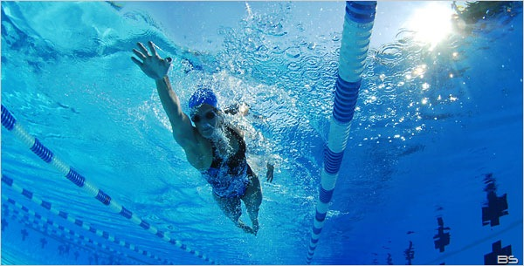
My hobbies is swim and read a book.

Slide 3
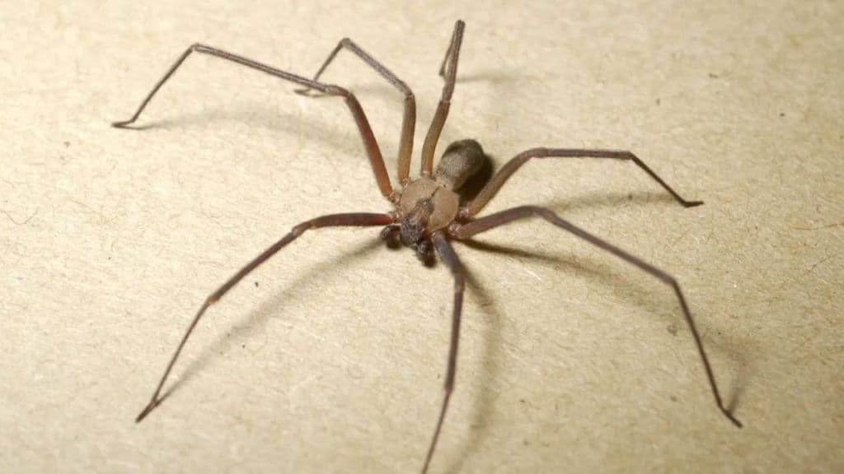
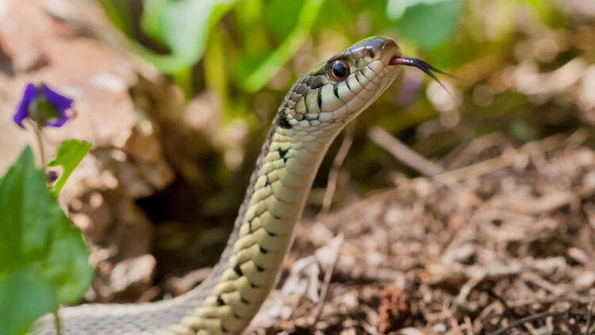
My fobbies is spider and snake.

Slide 4
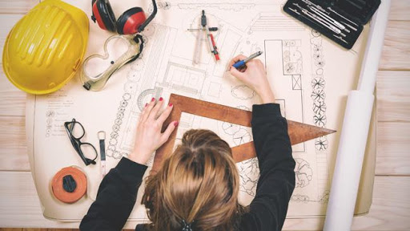
My Goals
I am planning to make a successful career
I want to be an interior designer when ı grow up

Slide 5
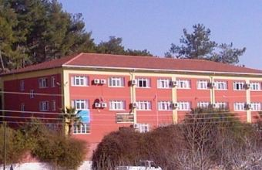
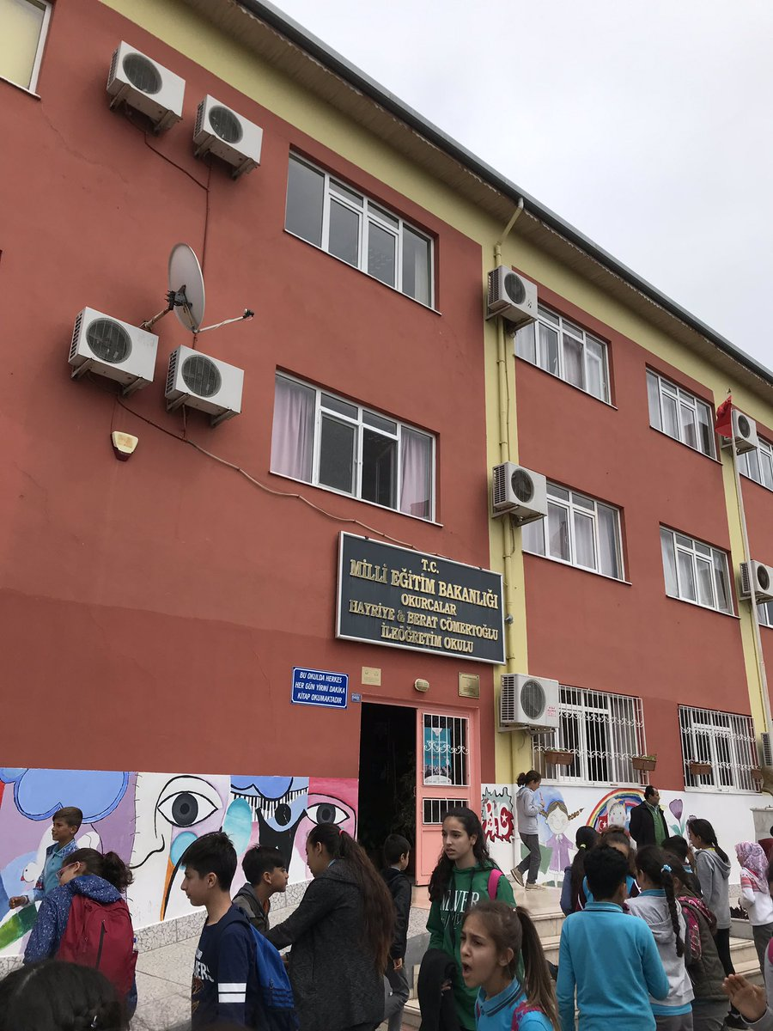
SCHOOL INTRODUCTION
I study 8th grade at okurcalar The name of my school BHC middle school.Phone:02425274085

Slide 6
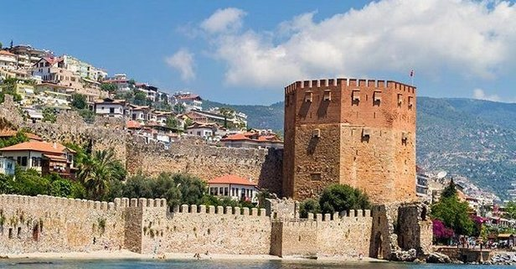
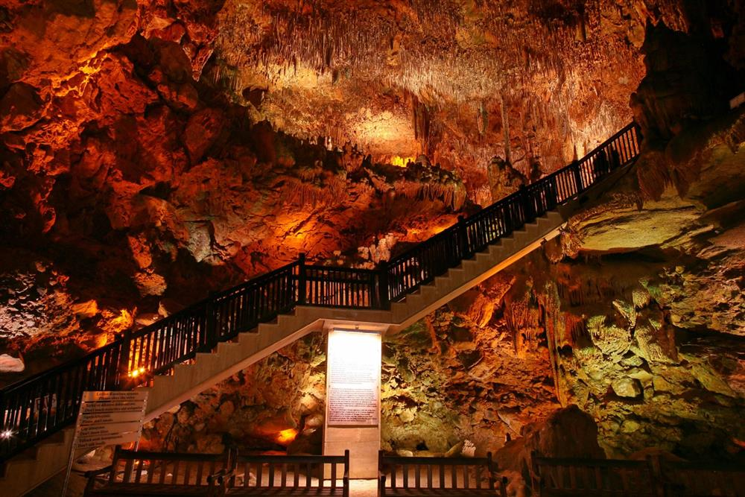
I LİVE İN ANTALYA/ALANYA
Alanya it’s nice tourists place.Population 327 thousand 503.Alanya Castle and Damlataş Cave are famous.

Slide 7
Good bye!
HOPE TO MEET SOON…

