Slide 1
Grow Healthy! Let’s Create a Well-Being Cocktail!
Our national jokes, comedians and comic characters
Buvinić Vana, Leal Renata, Yancheva Adriana

Slide 2
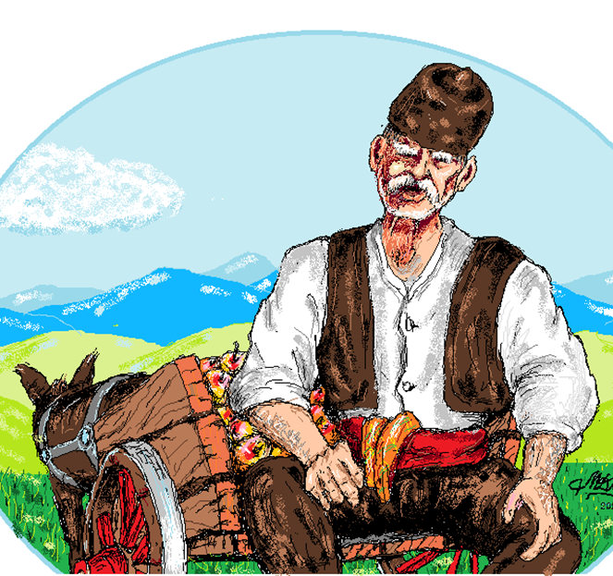
Hitar Petar
Hitar Petar - peasant trickster character from the Bulgarian folklore
the “typical Bulgarian”
He is regarded as a strictly positive figure and a hero of the common folk
As a character, Hitar Petar first appeared in the 16th–17th century, when Bulgaria was still under Ottoman rule.

Slide 3
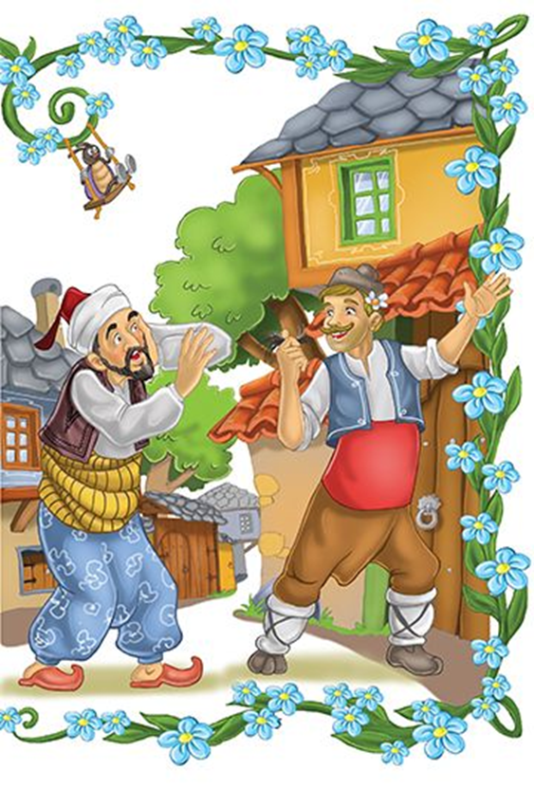
Origins of the character
Tales on his deeds are presented in the folklore of all regions inhabited by Bulgarians: Dobrudzha, Thrace and Macedonia.
In 1873, he was introduced to literature, with Iliya Blaskov publishing several anecdotes involving him.
Hitar Petar is similar to other characters of European and Oriental folklore, more notable are the ones from the Islamic folklore,the German, the Hungarian and the Jewish one.

Slide 4
Krali Marko and Hitar Petar
Hitar Petar and Krali Marko began to squabble about who is stronger.
"If I squeeze a stone," Krali Marko said, "I will reduce it to dust and ashes!"
And he really did this. He took a stone, pressed it, and reduced it to dust and ashes.
"That's nothing," said Hitar Petar, "If I get a stone and press it, I will make water start running from it."
And he rummaged in his bag, took out a piece of white cheese, pressed it, and squeezed water out of it.
"You are stronger indeed!" Krali Marko admitted astonished.
Krali Marko took an iron bar and said, "I can throw this bar to reach the stars!" And he threw it.
"But I can promise you golden mountains!" said Hitar Petar, "Give me the bar."
He took the bar and hit Krali Marko's head very hard. Krali Marko's sight grew dim.
"You are really stronger than me, I see golden mountains!"

Slide 5
Croatian jokes
Most jokes are based on mockery
Characters from jokes: the blonde, Perica/Ivica, neighbouring peoples people from different regions
Sometimes unfunny and offensive
Stupidity and stinginess are common themes

Slide 6
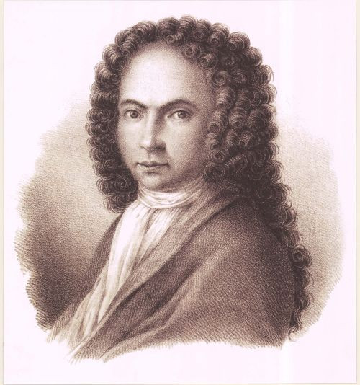
Stinginess (Marin Držić)
Marin Držić – Croatian Renaissance playwright
Skup – play similar to The Miser and Aulularia
A stingy old man finds gold and it becomes the only thing he cares about
Comedy of errors (man thinks all that matters is gold and everyone is after it)
Skup’s stinginess is the reason the drama starts

Slide 7
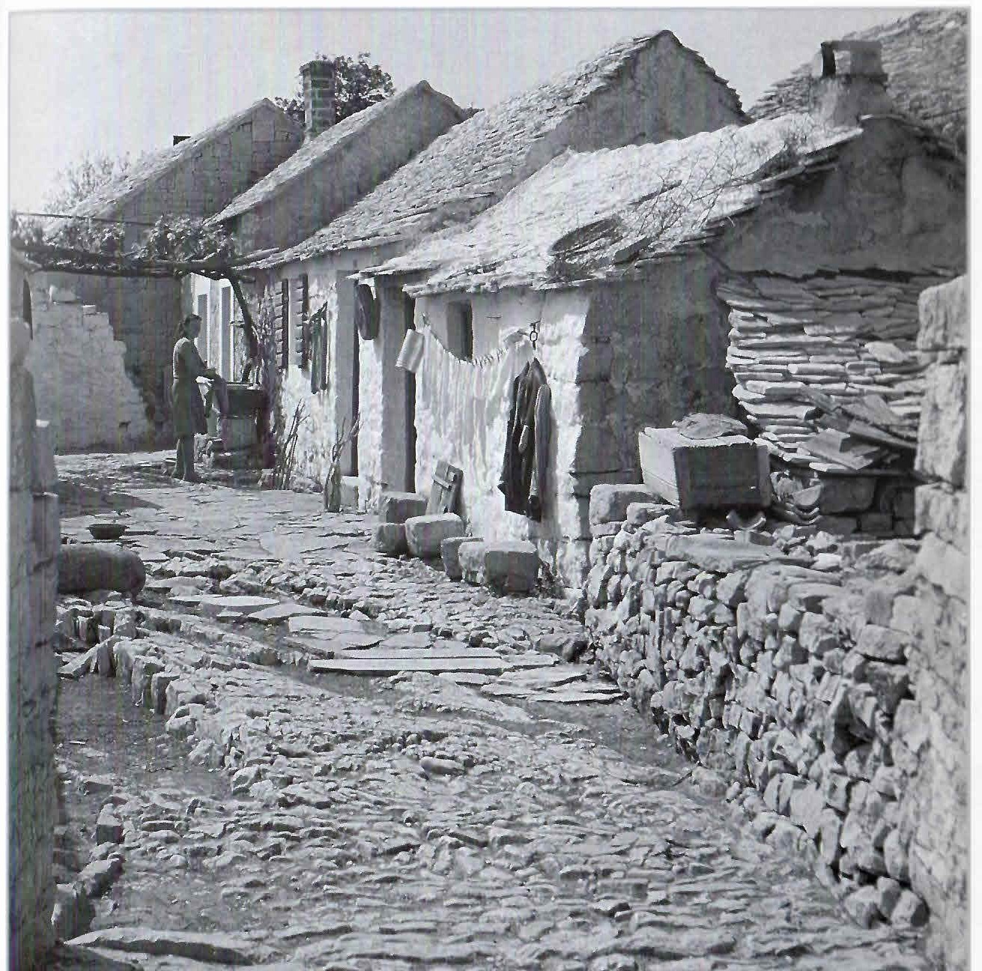
Jokes about stinginess
Hard life of our ancestors led to the stereotype of their stinginess
They were protective of their belongings, so others saw them as stingy.
Jokes about the stinginess of the people from all islands (especially Brač)
These jokes are very popular in our region

Slide 8
Jokes about „Bračani”
Bračanin – person from Brač
Bračani – people of Brač
In the rest of the world, the Scots are the ones considered stingy. So how were the Scots created? A man from Brač sent his son to Britain.
How were lizards created? A Bračanin fed alligators.
How do you know which boat is carrying Bračani? There aren’t any seagulls following it.
Which animal is Bračanin’s favourite? Giraffe – it’s in his yard but it eats from the neighbour’s.
Bračanin is buying a ticket for Hajduk-Dinamo, and he gives 50kn. The salesman tells him the ticket is 100, but Bračanin responds that he’s only there for Hajduk.

Slide 9
Jokes about „Bračani” II
How does a Bračanin shower? He sets a forest on fire and wait for the water bomber.
Why is Bračanin angry at the public transport prices going down? Because he’s saving less money by walking.
An old Bračanin is surrounded by his family on his deathbed. He begins to ask for all his sons. Mate, are you here? Šime, are you here? And so on. They all come to him and say: yes, father, we’re here. Then he responds: if you’re all here, why is the kitchen light on?!
What does a Brač buffet look like? An overturned table with some oil and cheese on one side, a piece of lamb and fish on the other.

Slide 10
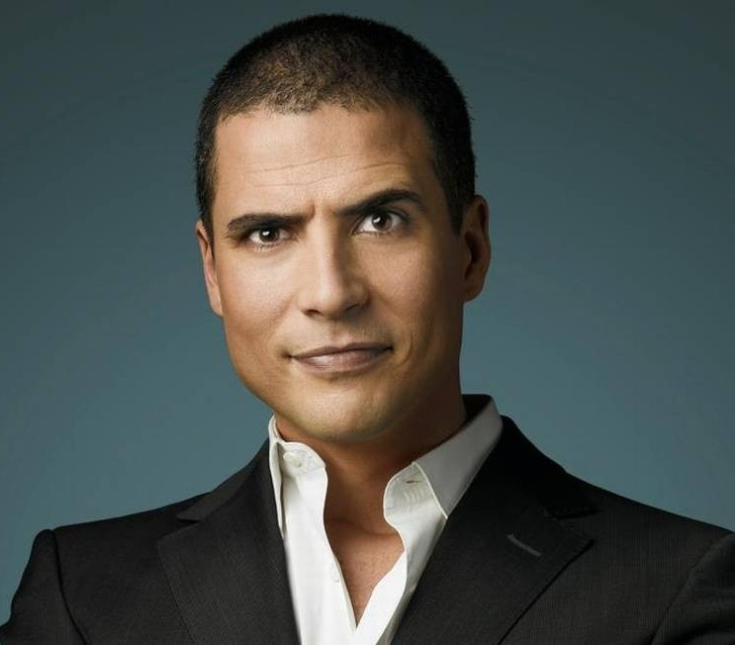
Ricardo Araújo Pereira
Born in the Lisbon parish of São Sebastião da Pedreira
Grew up in the Benfica area
Son of a TAP pilot and an on-board assistant
47 years old
He is a Portuguese comedian and columnist
His books are famous all over the world
Most popular book is „Smelly cat”

Slide 11
Pereira’s jokes
“How is virgin olive oil made? - With the olives that were not eaten”.
“If you're feeling lonely, abandoned, thinking no one cares about you... delay a payment”
“I told a chemical joke... There was no reaction”

Slide 12
Pereira’s jokes II
“Law student when taking a real test:. - What is a fraud? - That's what the professor is doing - answers the student. The teacher is indignant: - come on, explain yourself. Then the student says: according to the Penal Code "everyone who takes advantage of the ignorance of the other to harm him commits fraud”

Slide 13
Smelly Cat (Gato Fedorento)
Gato Fedorento is a Portuguese surreal comedy group
The story of Gato Fedorento began in 2003
In May 2005, the new series of the Smelly Cat began (Série Barbosa)
In November 2005, a second DVD was released, containing all the sketches of the Meireles series
In October 2006, Smelly Cat decided to radically change the format of their program
Now comedians satirize current events

Slide 14
The End
Thank you for your attention!

