Slide 1
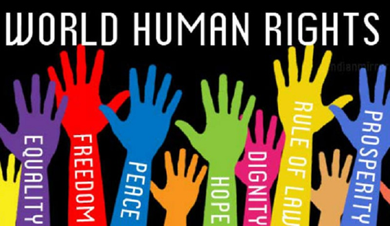
THE FIGHT FOR HUMAN RIGHTS AND THE SAKHAROV PRIZE
Franko Fabijanović
3.a

Slide 2
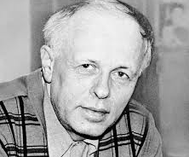
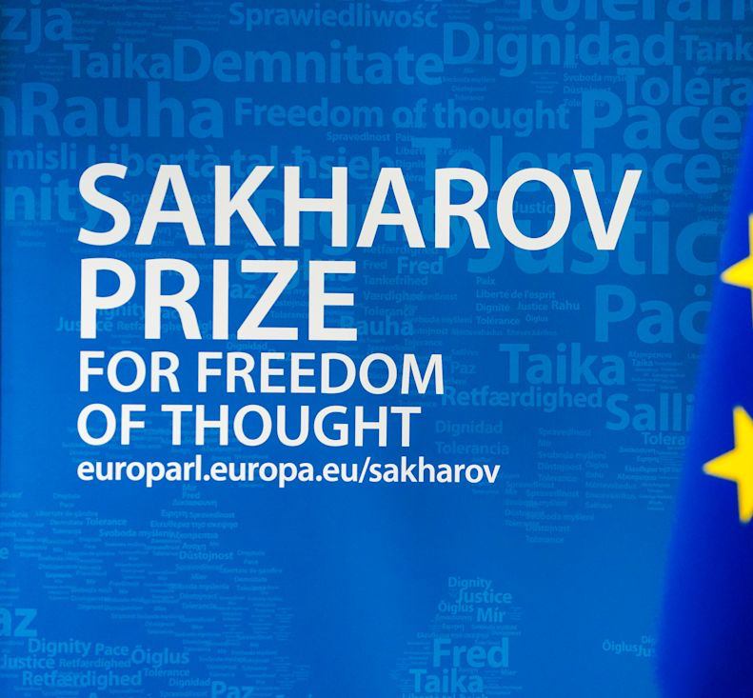
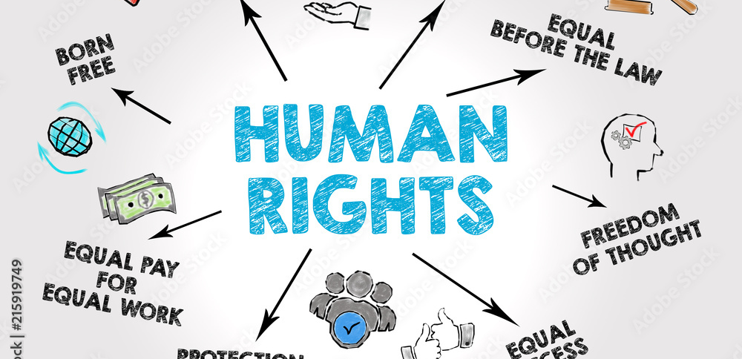
Sakharov Prize
Award for freedom of thought
It is awarded every year by the European Parliament
The award was established in 1988.
The prize is named after Soviet physicist Andrei Sakharov
The award is given in areas such as: freedom of expression, protection of minority rights, fight against violence...

Slide 3
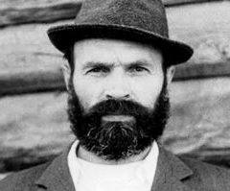
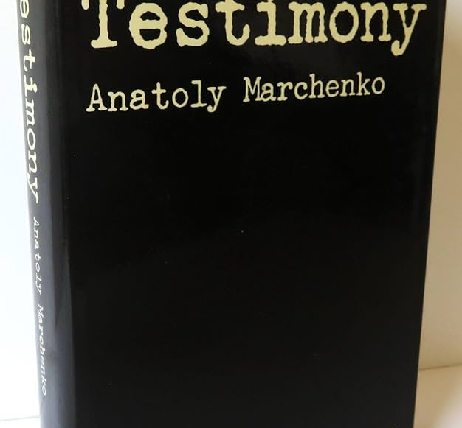
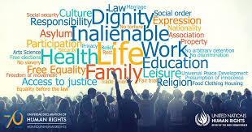
Anatolij Marchenko(1938.-1986.)
Soviet dissident, writer and human rights activist
He spent most of his life in prisons and labor camps for his open opposition to the Soviet regime
He wrote the book "My testimony" in which he talks about abuse in Soviet camps
He died due to a hunger strike

Slide 4
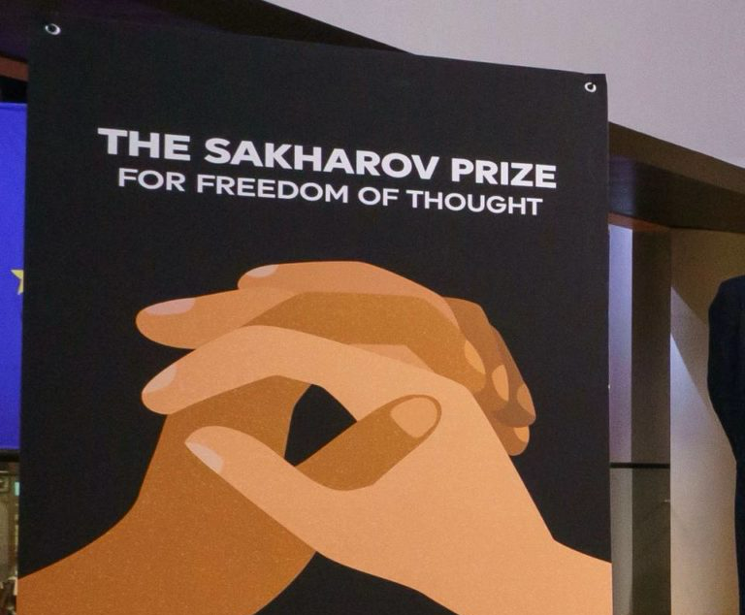
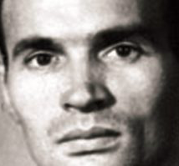
What was he fighting for?
Marchenko fought for: freedom of speech, the rights of political prisoners and the abolition of the camps
He received the Sahar Prize in 1988 after his death

Slide 5
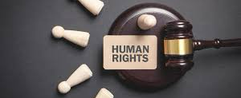
Denis Mukwege(1955.)
Congolese gynecologist and human rights activist
Helps women survivors of sexual violence in the Democratic Republic of Congo
Denis opened the Panzi Hospital in the city of Bukavu, where he treats victims of rape in armed conflicts

Slide 6
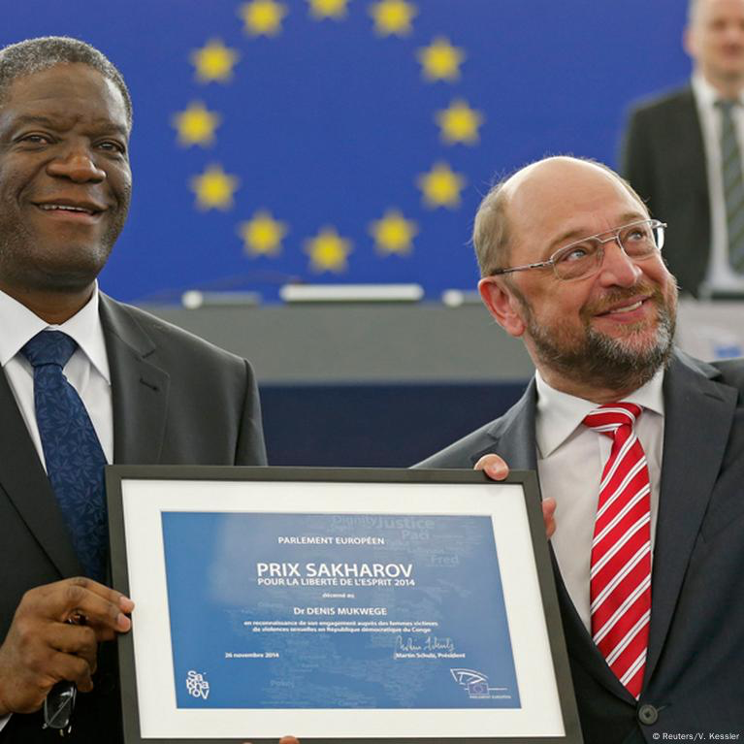
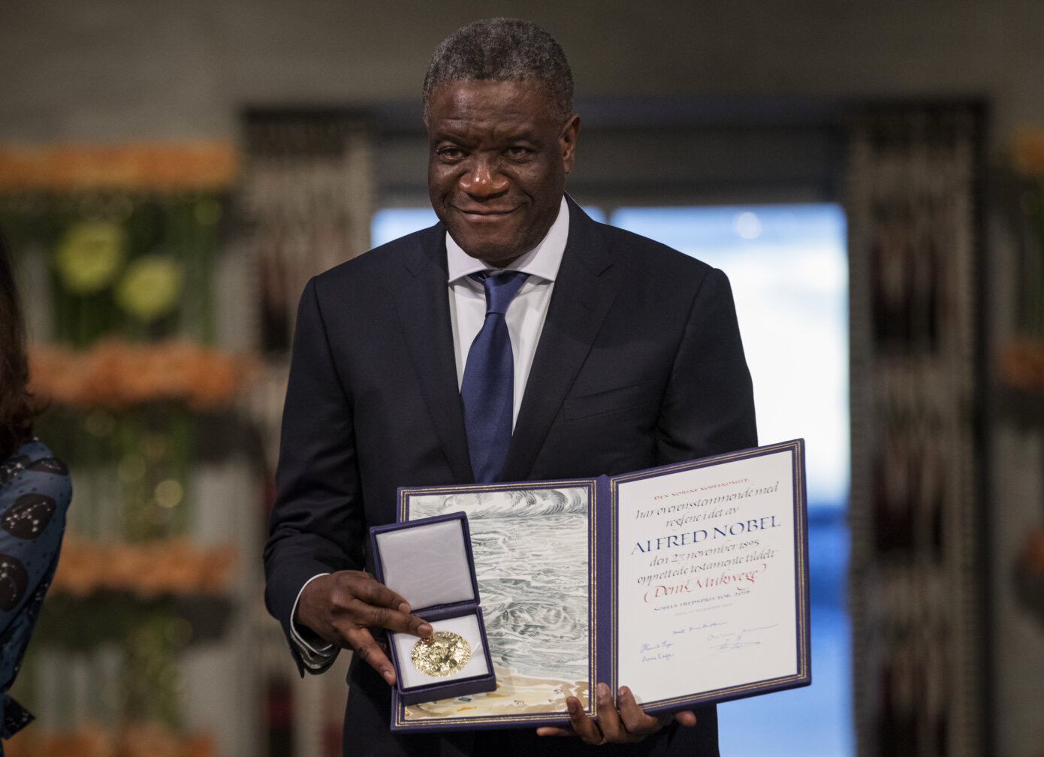
What did he stand for?
Advocated for: the rights of victims of sexual violence, the punishment of war criminals, the right to medical treatment
He is speaking about human rights at the united nations
He received many threats and was targeted for assassination
He received the Sakharov Prize for his courageous work in protecting rape victims in war zones in 2018.
In 2018, he received the Nobel Peace Prize

Slide 7
conclusion
The Sakharov Prize for Freedom of Thought is a symbol of the struggle for human rights, justice and freedom of expression. Denis Mukwege and Anatolij Marchenko are examples of courage and selfless struggle against injustice – Mukwege as a doctor who dedicated his life to victims of sexual violence, and Marchenko as a voice of truth in a regime that tried to silence all criticism. Their works inspire and remind us that an individual, guided by conscience, can change the world.

