Slide 1
The Sakharov Prize and Its Legacy
Marijan Vranješ

Slide 2
What is the Sakharov Prize?
Established by the European Parliament in 1988
Honors individuals or groups defending human rights and freedom of thought
Named after Andrei Sakharov, Soviet dissident and physicist
Awarded annually in Strasbourg, includes €50,000

Slide 3
Selection and Impact
Shortlist selected by EU committees in September
Final decision by the Conference of Presidents
Prize awarded in December
51 recipients as of 2024:
39 individuals (3 posthumously)
12 organizations

Slide 4
Nelson Mandela – The First Laureate
Co-recipient of the 1988 Sakharov Prize
Imprisoned for 27 years under apartheid
Led South Africa to democracy (1994–1999)
Advocated truth and reconciliation
Died in 2013 at age 95

Slide 5
Alexander Dubček
1989 Sakharov Laureate
Leader of 1968 Prague Spring, aimed at liberalizing socialism
Overthrown by Warsaw Pact invasion
Expelled from Communist Party, lived in obscurity until 1988

Slide 6
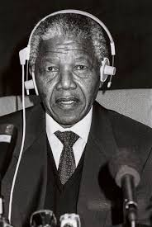
Shared Ideals – Mandela & Dubček
Both fought oppressive regimes
Advocated nonviolence, dignity, justice
Imprisoned or silenced for their beliefs
Became symbols of peaceful change

Slide 7
Nelson Mandela and Alexander Dubček remind us: Justice may be delayed, but not denied Peace is built through truth Voices of freedom can’t be silenced forever
Why These Stories Matter
THE END

